Slide 1
ELECTIONS RESULTS PREDICTION
GROUP #1

Slide 2



Chandrasheker B
Divya Madhuri
Rishitha Ravikumar
Notes:
Photo by Tamarcus Brown on Unsplash

Slide 3

Breaking Down The Topic!
To design an exit poll that will aid in projecting an overall win and the number of seats won by a certain party.
Visit https://bit.ly/3auUHUl to Get Started Free
Notes:
Product Screenshot Full MacBook

Slide 4





Approach
SEEKING OUR DATASET FROM KAGGLE
PREPROCESSISNG DATA FOR THE MODEL
DESCRIPTIVE STATISTICS FOR THE DATASET
DATACLEANING BY ENCODING AND SCALING
CONCLUSION AND FUTURE SCOPE

Slide 5
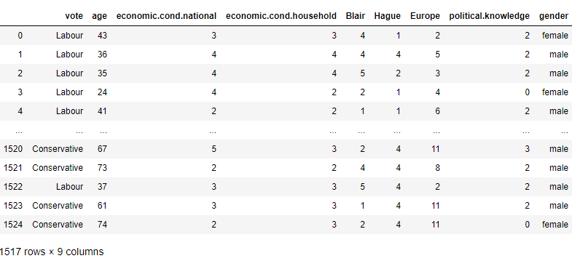
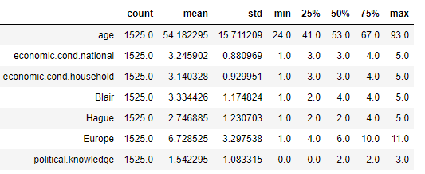
THE DATA

Slide 6
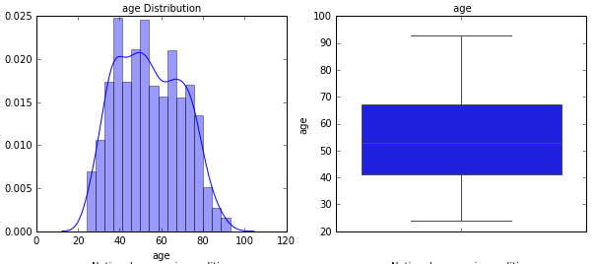
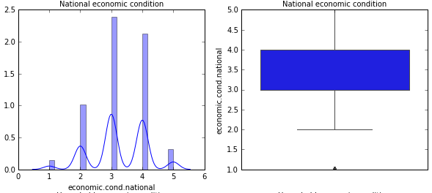
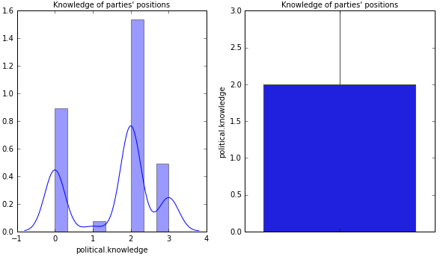
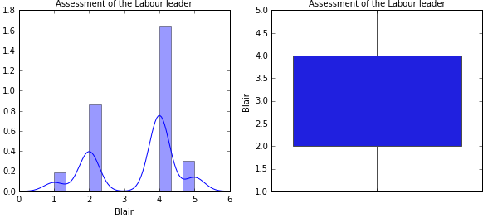
DESCRIPTIVE STATISTICS
UNIVARIATE ANALYSIS

Slide 7
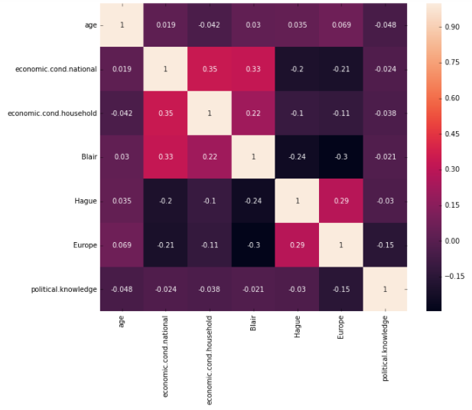
BIVARIATE ANALYSIS AND CORRELATIONS

Slide 8
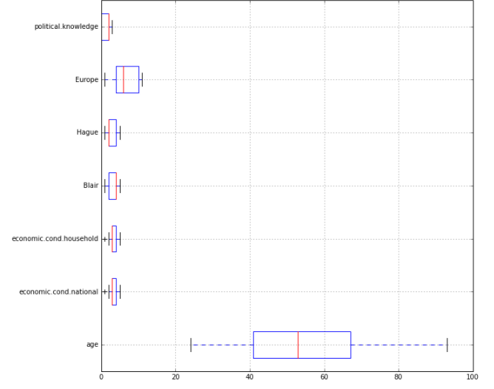
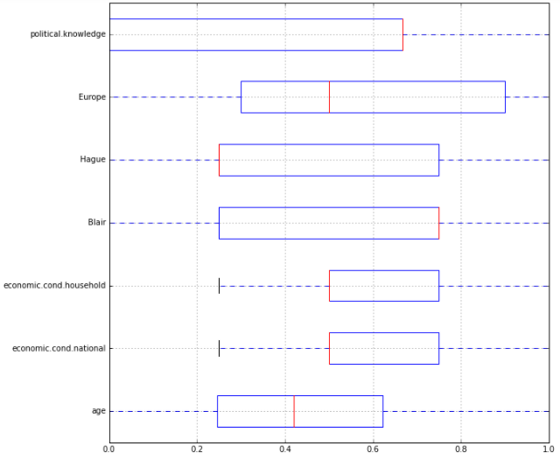
DATA CLEANING
SCALING AND ENCODING
AFTER
BEFORE
Visit https://bit.ly/3auUHUl to Get Started Free
Notes:
Product Screenshot Full MacBook

Slide 9
FUTURE SCOPE
Further analysis on this data
Using logistic regression
Linear discriminant analysis
KNN models
Naïve Bayer’s Models
Predict out election results and the winner!
See you in the final project!

Slide 10

Submissions
Mid Project Report
Pitch Video
Jupyter File
Github link
https://github.com/group1sdb/midsem_project

Slide 11

Thank you!

